Slide 1
CSCE 580
Artificial Intelligence
Ch.3 [P]: States and Searching
Spring 2015
Marco Valtorta
mgv@cse.sc.edu

Slide 2
Acknowledgment
The slides are based on the textbook [P] and other sources, including other fine textbooks
  [AIMA-2] and [AIMA-3]
  David Poole, Alan Mackworth, and Randy Goebel. Computational Intelligence: A Logical Approach. Oxford, 1998
  David Poole and Alan Mackworth. Artificial Intelligence: Foundations of Computational Agents. Cambridge, 2010 [P]
  Ivan Bratko. Prolog Programming for Artificial Intelligence, Third Edition. Addison-Wesley, 2001
  George F. Luger. Artificial Intelligence: Structures and Strategies for Complex Problem Solving, Sixth Edition. Addison-Welsey, 2009
Notes:
From: David Poole [poole@cs.ubc.ca]
Sent: Wednesday, August 06, 2008 8:47 PM
To: Valtorta, Marco
Cc: Alan Mackworth
Subject: Re: New edition of your textbook
Hi Marco,
You can point the students to
http://www.cs.ubc.ca/~poole/aibook/

Slide 3
Searching
Often we are not given an algorithm to solve a problem, but only a specification of what is a solution---we have to search for a solution
A typical problem is when the agent is in one state, it has a set of deterministic actions it can carry out, and wants to get to a goal state
Many AI problems can be abstracted into the problem of finding a path in a directed graph
Often there is more than one way to represent a problem as a graph

Slide 4

Directed Graphs
A graph consists of a set N of nodes and a set A of ordered pairs of nodes, called arcs
Node n₂ is a neighbor of n₁ if there is an arc from n₁ to n₂, that is, if (n₁, n₂) A. More commonly, we say that n₂ is a successor of n₁.
A path is a sequence of nodes (n₀, n₁,. . ., n_{k}) such that
(n_{i}, n_{i+1}) A. (Sometimes, a path is defined as a sequence of arcs.)
Given a set of start nodes and goal nodes, a solution is a
path from a start node to a goal node
Often there is a cost associated with arcs and the cost of a
path is the sum of the costs of the arcs in the path

Slide 5
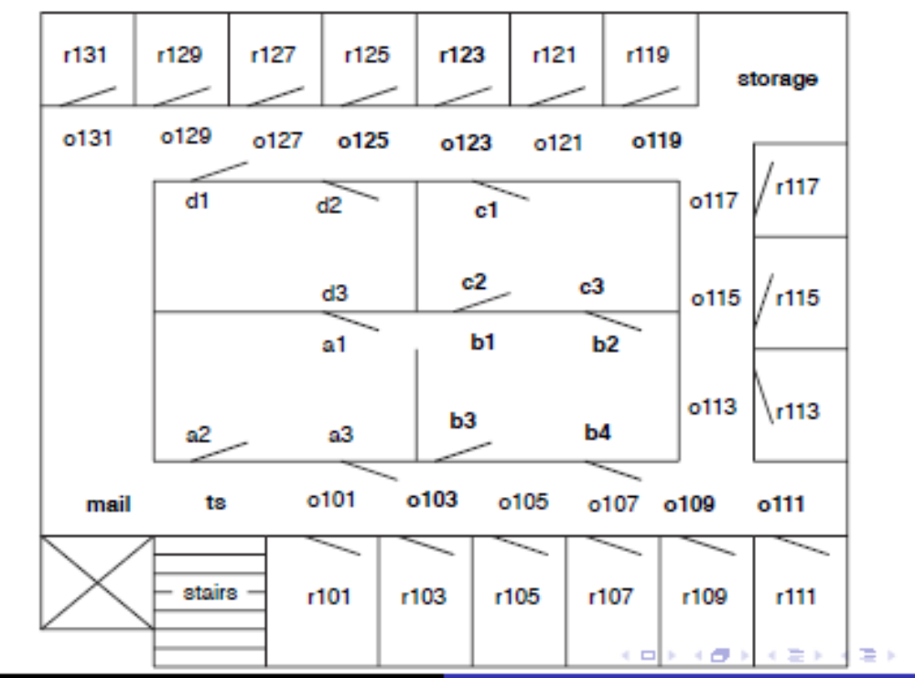
Example Problem for Delivery Robot
The robot wants to get from outside room 103 to the inside of room 123
Names (such as r101) labels interesting locations
Bold labels (such as mail) will be used to illustrate search

Slide 6
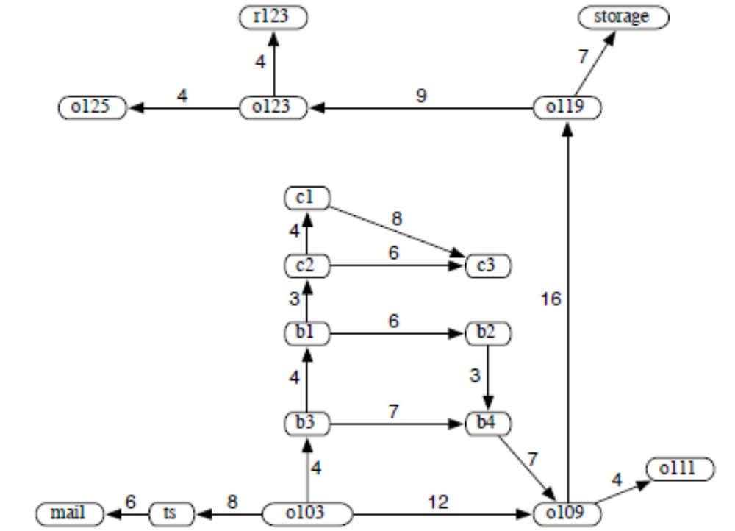
Graph for the Delivery Robot
Notes:
Fig. 3.2 [P]. Start node is o103, goal node is r123.

Slide 7
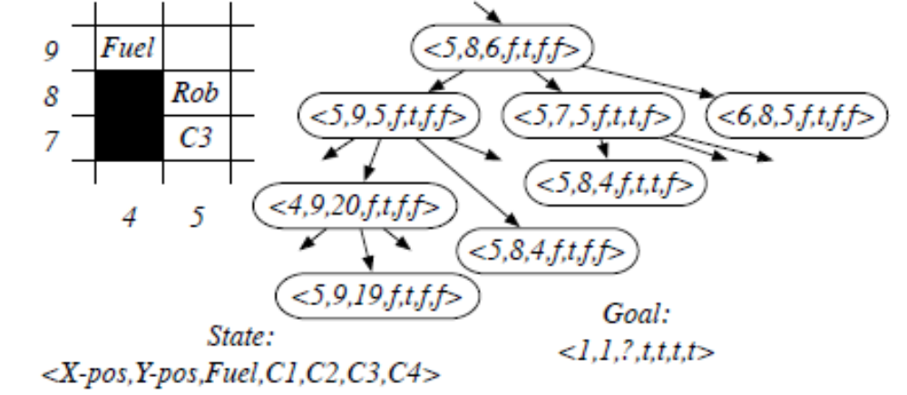
Partial Search Space for a Video Game
Grid game: collect coins C1, C2, C3, C4, don't run out of fuel, and end up at location (1, 1)
Notes:
[AIMA]

Slide 8
Graph Searching
Generic search algorithm: given a graph, start nodes, and goal nodes, incrementally explore paths from the start nodes
Maintain a frontier of paths from the start node that have been explored
As search proceeds, the frontier expands into the unexplored nodes until a goal node is encountered
The way in which the frontier is expanded defines the search strategy

Slide 9
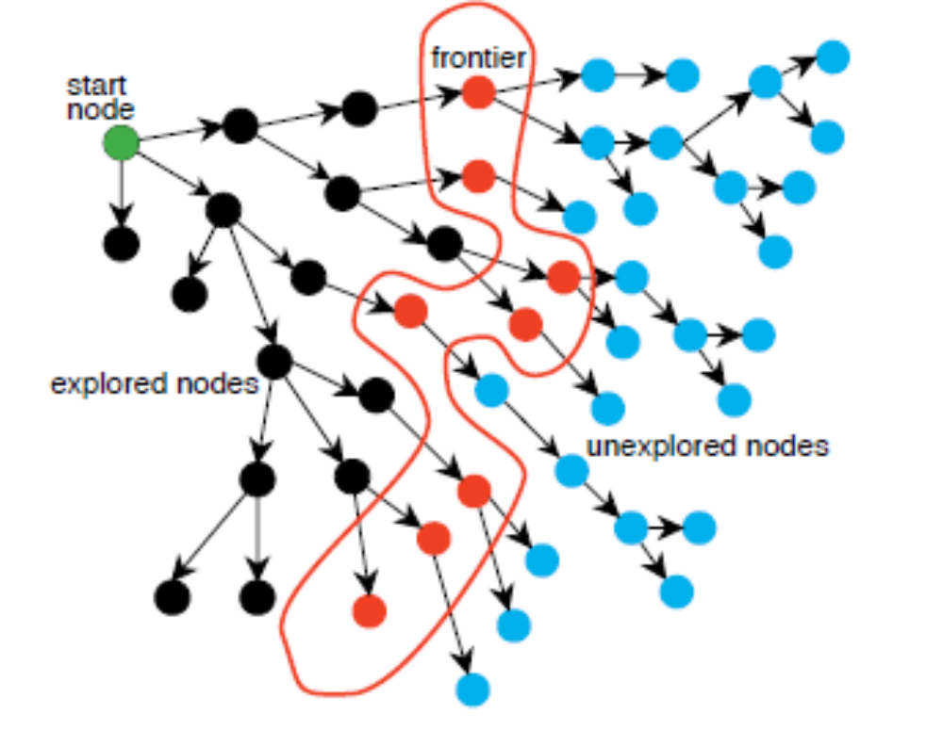
Problem Solving by Graph Searching

Slide 10
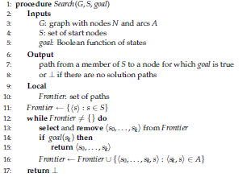
Graph Search Algorithm
More solution paths may be returned by continuing after line 15
Which value is selected from the frontier at each stage defines the search strategy
The neighbors defines the graph.
goal defines what is a solution
If the path chosen does not end at a goal node and the node at the end has no neighbors, extending the path means removing the path
Notes:
Fig. 3.4[P]

Slide 11
Depth-first Search
Depth-first search treats the frontier as a stack
It always selects one of the last elements added to the frontier.
If the list of paths on the frontier is [p₁, p₂, . . .]
  p₁ is selected. Paths that extend p₁ are added to the front of the stack (in front of p₂)
  p₂ is only selected when all paths from p₁ have been explored.

Slide 12
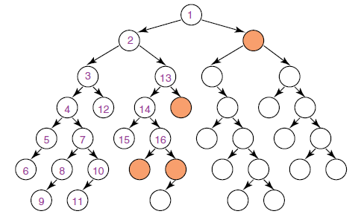
Illustrative Graph---Depth-first Search

Slide 13
Complexity of Depth-first Search
Depth-first search isn't guaranteed to halt on infinite graphs or on graphs with cycles, even if the goal node is at finite distance from the start node
The space complexity is linear in the size of the path being explored
Search is unconstrained by the goal until it happens to stumble on the goal

Slide 14
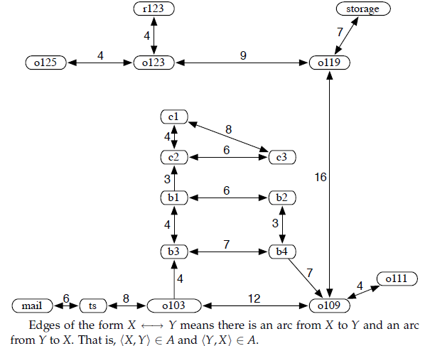
A Graph with Cycles
Notes:
Fig.3.6[P]. This can be used to illustrate non-termination of Depth-First Search.

Slide 15
Breadth-first Search
Breadth-first search treats the frontier as a queue.
It always selects one of the earliest elements added to the frontier
If the list of paths on the frontier is [p₁, p₂, . . ., p_{r}]
  p₁ is selected. Its neighbors are added to the end of the queue, after p_{r}
  p₂ is selected next

Slide 16
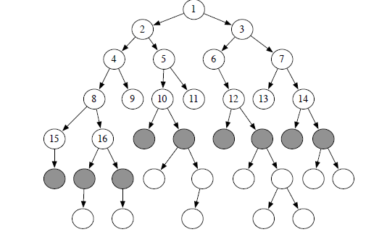
Order of Node Expansion in BFS
Notes:
Fig. 3.7[P]

Slide 17
Complexity of Breadth-first Search
The branching factor of a node is the number of its neighbors
If the branching factor for all nodes is finite, breadth-first search is guaranteed to find a solution if one exists
It is guaranteed to find the path with fewest arcs
Time complexity is exponential in the path length: b^{n}, where b is branching factor, n is path length
The space complexity is exponential in path length: b^{n}
Search is unconstrained by the goal

Slide 18
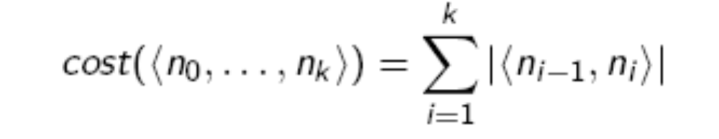
Lowest-cost-first search (Dijkstra’s algorithm; the uniform cost algorithm)
Sometimes there are costs associated with arcs. The cost of a path is the sum of the costs of its arcs
At each stage, lowest-cost-first search selects a path on the frontier with lowest cost
The frontier is a priority queue ordered by path cost
It finds a least-cost path to a goal node
When arc costs are equal, it is identical to breadth-first search, except for the stopping condition

Slide 19
Heuristic Search
Idea: don't ignore the goal when selecting paths
Often there is extra knowledge that can be used to guide the search: heuristics
h(n) is an estimate of the cost of the shortest path from node n to a goal node
h(n) uses only readily obtainable information (that is easy to compute) about a node
h can be extended to paths: h(<n₀, . . ., n_{k}>) = h(n_{k})
h(n) is an underestimate if there is no path from n to a goal that has path cost less than h(n)
  i.e., h(n) is a lower bound of the cost of the shortest path to n, f*(n) = h*(n)

Slide 20
Example Heuristic Functions
If the nodes are points on a Euclidean plane and the cost is the distance, we can use the straight-line distance from n to the closest goal as the value of h(n)
If the nodes are locations and cost is time, we can use the distance to a goal divided by the maximum speed
If the goal is to collect all of the coins and not run out of fuel, the cost is an estimate of how many steps it will take to collect the rest of the coins, refuel when necessary, and return to goal position

Slide 21
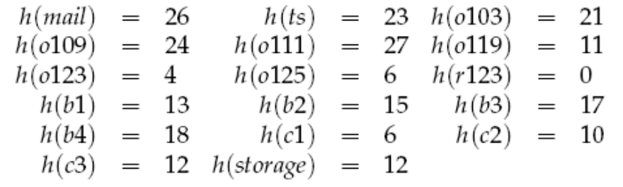
Example: Euclidean Distance
Notes:
[P]

Slide 22
Best-first Search
Idea: select the path whose end is closest to a goal according to the heuristic function.
Best-first search selects a path on the frontier with minimal h-value
It treats the frontier as a priority queue ordered by h

Slide 23

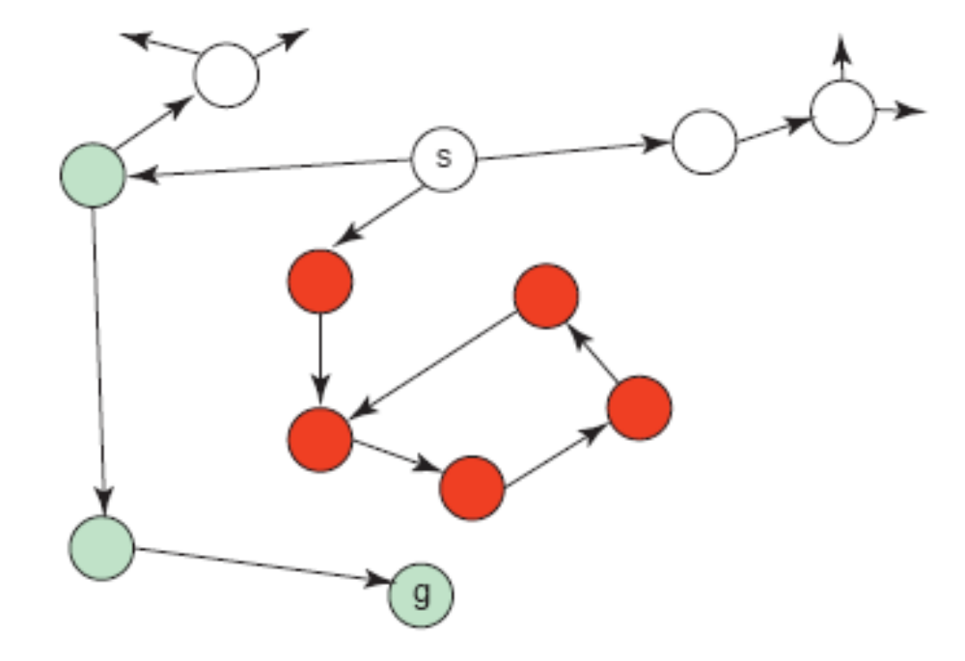


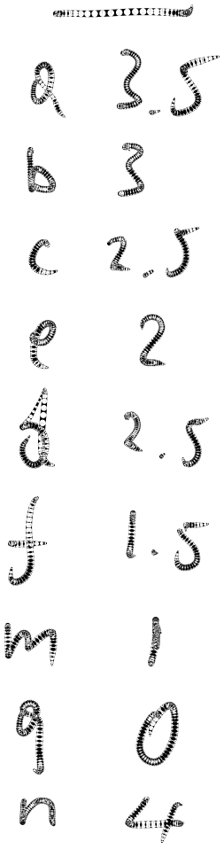

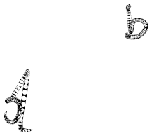

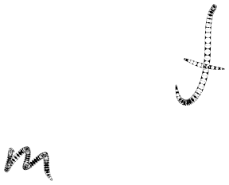
Illustrative Graph for Best-first Search

Slide 24
Complexity of Best-first Search
It uses space exponential in path length
It isn't guaranteed to find a solution, even if one exists
It doesn't always find the shortest path

Slide 25
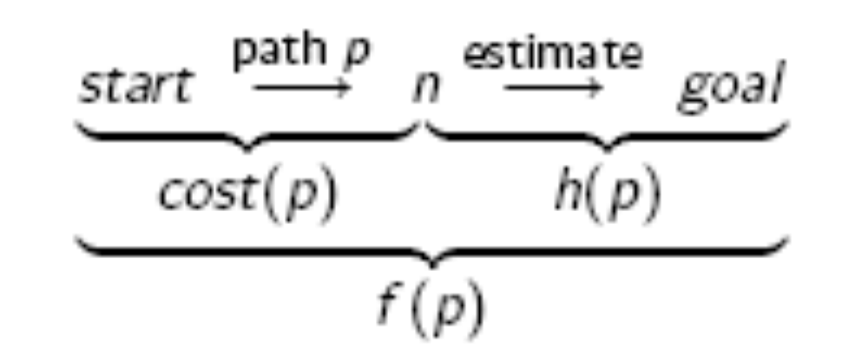
A* Search
A* search uses both path cost and heuristic values
cost(p) is the cost of the path p
h(p) estimates of the cost from the end of p to a goal
f (p) = cost(p) + h(p)
  f (p) estimates of the the total path cost of going from a start node to a goal via p

Slide 26
A* Search Algorithm
A* is a mix of lowest-cost-first (Dijkstra’s algorithm) and best-first search
It treats the frontier as a priority queue ordered by f (p)
It always selects the node on the frontier with the lowest estimated distance from the start to a goal node constrained to go via that node

Slide 27
Admissibility of A*
If there is a solution, A always finds an optimal solution (the first path to a goal selected) if
  the branching factor is finite
  arc costs are bounded above zero (there is some epsilon > 0 such that all of the arc costs are greater than epsilon), and
  h(n) is an underestimate of the cost of the shortest path from n to a goal node

Slide 28
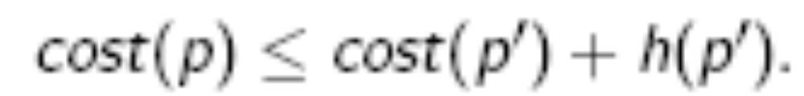
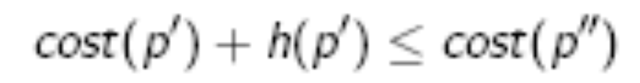
Why is A* admissible? Proof Sketch
If a path p to a goal is selected from a frontier, can there be a shorter path to a goal?
Suppose path p’ is on the frontier. Because p was chosen before p’, and h(p) = 0:
Because h is an underestimate:
for any path p’’ to a goal that extends p’
So cost(p) ≤ cost(p”) for any other path p” to a goal
There is always an element of an optimal solution path on the frontier before a goal has been selected
A* halts because the costs of the paths on the frontier keeps increasing and will eventually exceed any finite number

Slide 29
Admissibility of A*: Proof
Proposition 3.1 [P]. (A* admissibility): If there is a solution, A* always finds a solution, and the first solution found is an optimal solution, if the branching factor is finite (each node has only a finite number of neighbors), arc costs are greater than some e > 0, and h(n) is a lower bound on the actual minimum cost of the lowest cost path from n to a goal node.
Proof.
Part A: A solution will be found. If the arc costs are all greater than some e > 0, eventually for all paths p in the frontier, cost(p) will exceed any finite number, and thus will exceed a solution cost if there is one (at depth in the search tree no greater than m/e, where m is the solution cost). As the branching factor is finite, there is only a finite number of nodes that need to be expanded before the search tree could get this size, but the A* search would have found a solution by then.
Part B: The first path to a goal selected is an optimal path. The f-value for any node on an optimal solution path is less than or equal to the f-value of an optimal solution. This is because h is an underestimate of the actual cost from a node to a goal. Thus the f-value of a node on an optimal solution path is less than the f-value for any non-optimal solution. Thus a non-optimal solution can never be chosen while there is a node on the frontier that leads to an optimal solution (as an element with minimum f-value is chosen at each step). So, before it can select a non-optimal solution, it will have to pick all of the nodes on an optimal path, including each of the optimal solutions.

Slide 30
Admissibility of A*
See Section 3.1.3 of: Judea Pearl. Heuristics: Intelligent Search Strategies for Computer Problem Solving. Addison-Wesley, 1984.
  Especially Lemma 1 and Theorem 2 (pp. 77-78)
Note that admissibility of A* does not require monotonicity of the heuristics. [AIMA] claims otherwise on p.99. The confusion is probably due to the fact that admissibility only requires an optimal solution to be returned for a goal node (for which h=0), rather than for every node that is CLOSED
A* finds shortest paths to every node it closes with monotone (consistent) heuristics

Slide 31
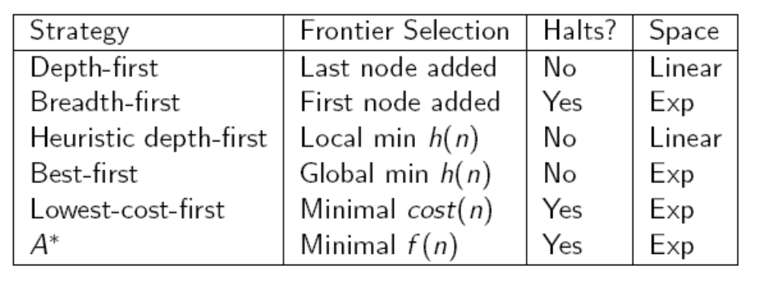
Summary of Search Strategies

Slide 32
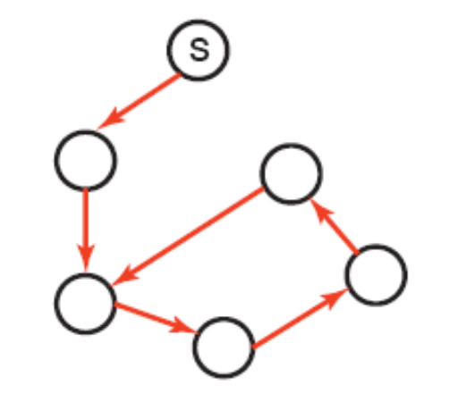
Cycle Checking
A searcher can prune a path that ends in a node already onvthe path, without removing an optimal solution.
Using depth-first methods, with the graph explicitly stored, this can be done in constant time.
For other methods, the cost is linear in path length.
Notes:
Section 3.7.1[P]

Slide 33
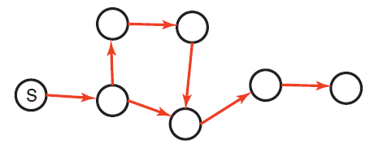
Multiple-Path Pruning
Multiple path pruning: prune a path to node n that the searcher has already found a path to it
Multiple-path pruning subsumes a cycle check
This entails storing all nodes it has found paths to
Want to guarantee that an optimal solution can still be found

Slide 34
Multiple-Path Pruning and Optimal Solutions
Problem: what if a subsequent path to n is shorter than the first path to n?
  remove all paths from the frontier that use the longer path.
  change the initial segment of the paths on the frontier to use the shorter path
  ensure this doesn't happen. Make sure that the shortest path to a node is found first
    True for the lowest-cost algorithm (Dijkstra’s algorithm)
    Not true in general for A*, but true for A* with monotone (consistent) heuristics

Slide 35
Multiple-Path Pruning and A*
Suppose path p to n was selected, but there is a shorter path to n. Suppose this shorter path is via path p’ on the frontier.
Suppose path p’ ends at node n’
cost(p) + h(n) <= cost(p’) + h(n’) because p was selected before p’
cost(p’) + cost(n’, n) < cost(p) because the path to n via p’ is shorter
cost(n’, n) < cost(p) - cost(p’) <= h(n’) - h(n):
You can ensure this doesn't occur if
|h(n’) - h(n)| < cost(n’, n)
  Such a heuristic is said to be consistent

Slide 36
Monotone Restriction
Heuristic function h satisfies the monotone restriction if |h(m) - h(n)| <= cost(m, n) for every arc <m,n>
If h satises the monotone restriction, A* with multiple path pruning always finds the shortest path to a goal

Slide 37
Iterative Deepening
So far all search strategies that are guaranteed to halt use exponential space
Idea: let's recompute elements of the frontier rather than saving them
Look for paths of depth 0, then 1, then 2, then 3, etc
You need a depth-bounded depth-first searcher
If a path cannot be found at depth B, look for a path at depth B + 1. Increase the depth-bound when the search fails unnaturally (depth-bound was reached)

Slide 38
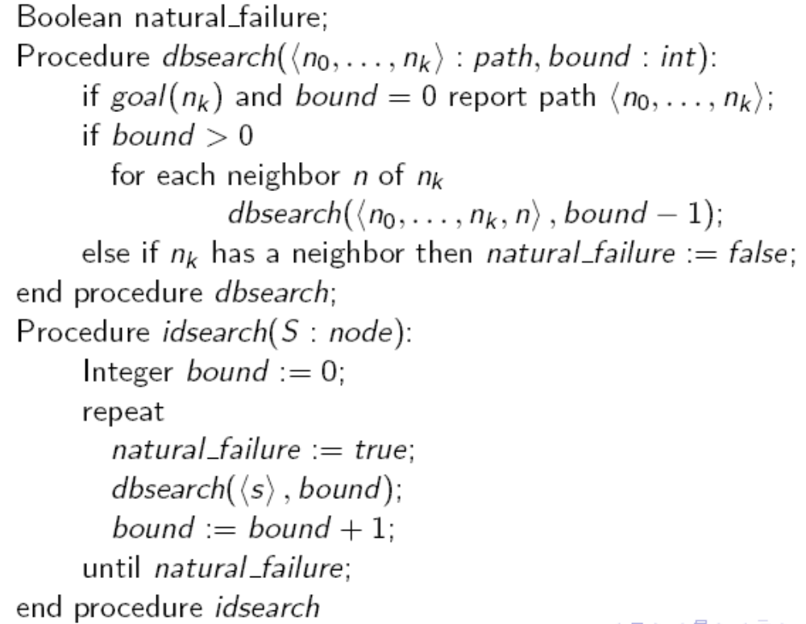
Iterative-deepening search
Notes:
This is similar to procedure IdSearch(G,s,goal), Fig. 3.10[P]. I think that the slide is correct in having natural_failure as a global variable; in Fig.3.10 [P], there are two such variables, and one is local.

Slide 39
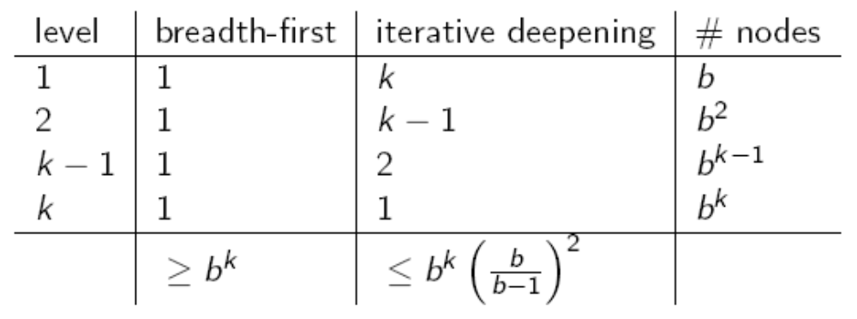
Iterative Deepening Complexity
Complexity with solution at depth k and branching factor b:

Slide 40
Depth-first Branch-and-Bound
Way to combine depth-first search with heuristic information
Finds optimal solution
Most useful when there are multiple solutions, and we want an optimal one
Uses the space of depth-first search.

Slide 41
Depth-first Branch-and-Bound
Idea: maintain the cost of the lowest-cost path found to a goal so far, call this bound
If the search encounters a path p such that cost(p) + h(p) >= bound, path p can be pruned
If a non-pruned path to a goal is found, it must be better than the previous best path. This new solution is remembered and bound is set to its cost
The search can be a depth-first search to save space
How should the bound be initialized?

Slide 42
Depth-first Branch-and-Bound: Initializing Bound
The bound can be initialized to infinity
The bound can be set to an estimate of the optimal path cost. After depth-first search terminates either:
  A solution was found
  No solution was found, and no path was pruned
  No solution was found, and a path was pruned
Notes:
I am not sure what information is conveyed by the difference between the last two options!

Slide 43
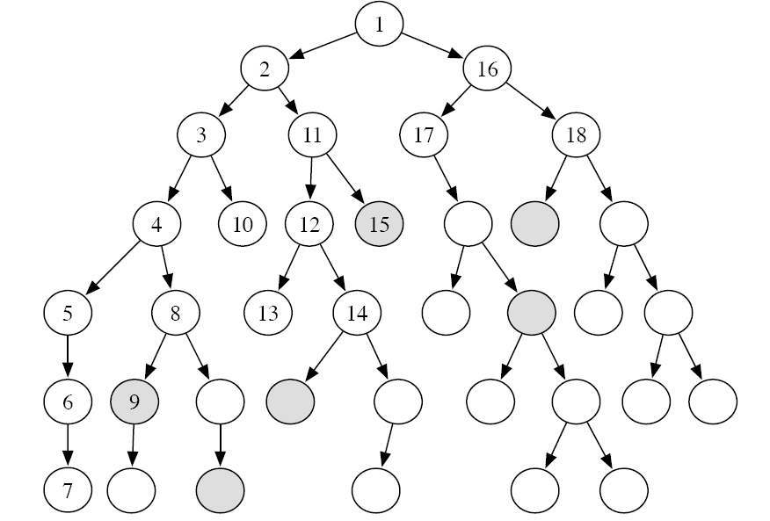
Depth-First B&B Search Example
Notes:
Figure 3.12 [P]

Slide 44
Direction of Search
The definition of searching is symmetric: find path from start nodes to goal node or from goal node to start nodes
Forward branching factor: number of arcs out of a node
Backward branching factor: number of arcs into a node
Search complexity is b^{n}. Should use forward search if forward branching factor is less than backward branching factor, and vice versa
Note: sometimes when graph is dynamically constructed, you may not be able to construct the backwards graph

Slide 45
Bidirectional Search
You can search backward from the goal and forward from the start simultaneously
This wins as 2^{b/k} is much less than b^{k} . This can result in an exponential saving in time and space
The main problem is making sure the frontiers meet
This is often used with one breadth-first method that builds a set of locations that can lead to the goal. In the other direction another method can be used to find a path to these interesting locations

Slide 46
Island Driven Search
Idea: find a set of islands between s and g
This can win as mb^{k/m} is much less than b^{k}
The problem is to identify the islands that the path must pass through. It is difficult to guarantee optimality.
You can solve the subproblems using islands, thus creating a hierarchy of abstractions

Slide 47

Dynamic Programming
Idea: for statically stored graphs, build a table of dist(n), the actual distance of the shortest path from node n to a goal
This can be built backwards from the goal:
This can be used locally to determine what to do. There are two main problems:
  You need enough space to store the graph
  The dist function needs to be recomputed for each goal

